Slide 1
BerkeleyGW IO Optimization
Graham Wood, Gabriel Dick, Nicholas Schoeck

Slide 2
Overview
Background Recap
Process
Changes
Results
Comparison to expected
What we learned
Questions?

Slide 3

BerkeleyGW IO Optimization
Part of National Renewable Energy Lab in Colorado
BerkeleyGW is a set of code that calculates the quasiparticle properties and optical responses of a variety of materials.
The different materials include bulk semiconductors, insulators, metals, and nano-systems.
It uses the GW approach, based on approximating the electron self-energy as a part of an expansion in a Coulomb interaction, to get quasiparticle band gaps and dispersion relations.
Self-energy is when a particle interacts with a many-body system, creates a cloud, and the cloud disrupts the particle’s motion.
Coulomb’s Law is a quantification of the force between two electrically charged particles.

Slide 4

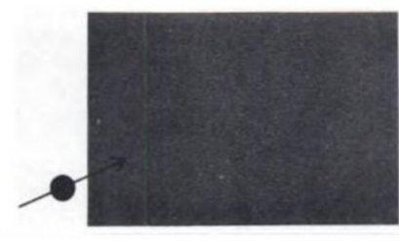

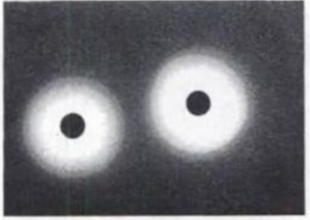
Quasi-Particles
Here is an example of the GW approximation.
Many electrons interacting in a uniform, neutral system.
Shoot an electron into this system, and the extra electron repels the others.
A lack of electrons create a “hole” as other electrons are pushed away
The extra electron + this hole is what the “quasiparticle” is.
Two quasiparticles interact through a Coulomb interaction.
A
B
C
D

Slide 5
Process
Weekly meetings with Derek
Incremental Development
Tasks assigned each week

Slide 6
Issues with the code
Code was cluttered and difficult to read
Relied on multiple files for IO
A lot of data dependencies that could be removed
Bottlenecks on large wavefunction files
Notes:
We spent a lot of time going through sections of code and determining what was important to what we were doing and trying to understand how things were being done. The science was a major roadblock trying to disseminate what was important to the science and what was technically important for us to understand
Since the program originally read in wave functions in serial the program would become heavily bottlenecked on large electron systems that have gigabytes to terabytes of data

Slide 7
Changes - Kernel
Absorption IO code was broken out of main program and a Kernel was created
Code was organized in a more readable and logical way
Unnecessary data dependencies were removed
Notes:
The first thing we did was separate the IO in the Absorption files and put them into a Kernel to ease the development process. This also allows us to test IO without running the whole program making it much simpler to run.
Most of the data dependencies were removed except for a couple, making the file simpler and easier to read.

Slide 8
Changes - HDF5
Using Epsilon HDF5 implementation as a template
Modified Absorption code to utilize HDF5 and perform IO in parallel
This required us to modify the Epsilon IO code to parallelize over K-points
(In contrast epsilon parallelized over Bands)
Notes:
Luckily HDF5 and parrellization has already been implemented on Epsilon, so using Epsilon as a base we were able to adapt the epsilon code for absorption

Slide 9
Technical details of the code
Three main functions
Read_hdf5_wfn_absorption_fine
Responsible for initializing much of the data types
Allocating space
Initializing MPI
Calling Distrib and read_hdf5_kpoints_block
Distrib
Distributes data among processes
Read_hdf5_kpoints_block
Responsible for reading in the K-Points
Notes:
The kernel is broken down into three main sections required to perform IO
The first function is mainly responsible for initializing much of the data types and allocating the proper amount of space for them. This function is also responsible for setting up MPI and calling the Distrib and read Kpoints functions.

Slide 10
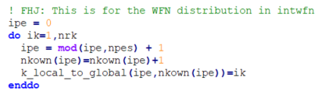
Technical Details of Kernel
The second index of the wavefunction is the g-vectors for all k-points stacked together, i.e. it’s a composite index. For example, let’s say you have 4 k-points with number of g-vectors ngk=[5,7,6,4] at these different k-points. Then this composite index has size 5+7+6+4=22, with the first kpoint’s 5 gvectors listed first, then the second kpoint’s 7 gvectors
Distrib Function
Responsible for distributing the k-points among all the processors.
The process is going through the list of k-points and assigning itself as the owner.
Then it changes the global list of k-points so it knows that this process owns the k-points it grabs.
Notes:
The distribute function is ran by each node. Each node loops through it’s allotted number of k-points and assigns them to itself. Once it does that it notifies the global list of each K-point that it is claiming

Slide 11
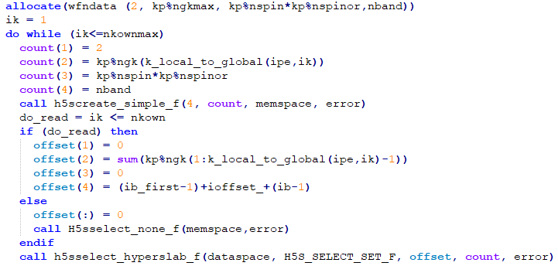
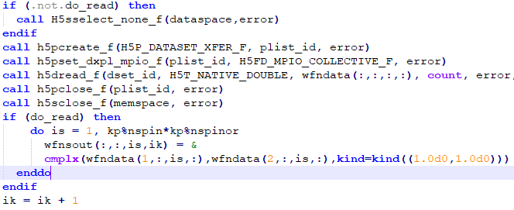
Technical Details Cont
Read_hdf5_kpoints_block
This subroutine reads the k-points in from the wavefunction data file.
Each process goes through the k-points it owns and assigns information to the indices of ‘count’.
It creates an object for the data for HDF5 calling the ‘h5screate_simple_f’ subroutine
Then assigns the offset indices for the data previously read into count.
After all the indices have been assigned, all of the HDF5 subroutines are called to create the new objects, and read in the data.

Slide 12
Results
Bottleneck occurs when using large number of nodes
Results from small scale test runs show improvement, but aren’t telling of larger datasets
IO speedup of approximately 2x~ have been observed on small - moderate test cases
Still working on Terabyte wavefunction test

Slide 13
What we learned
In depth knowledge of HDF5
Fortran90
Difficulties of working with someone far away on different systems
Difficulties of working on a large, preexisting code

Slide 14
Questions

